Slide 1
Power BI
Pros and Cons

Slide 2
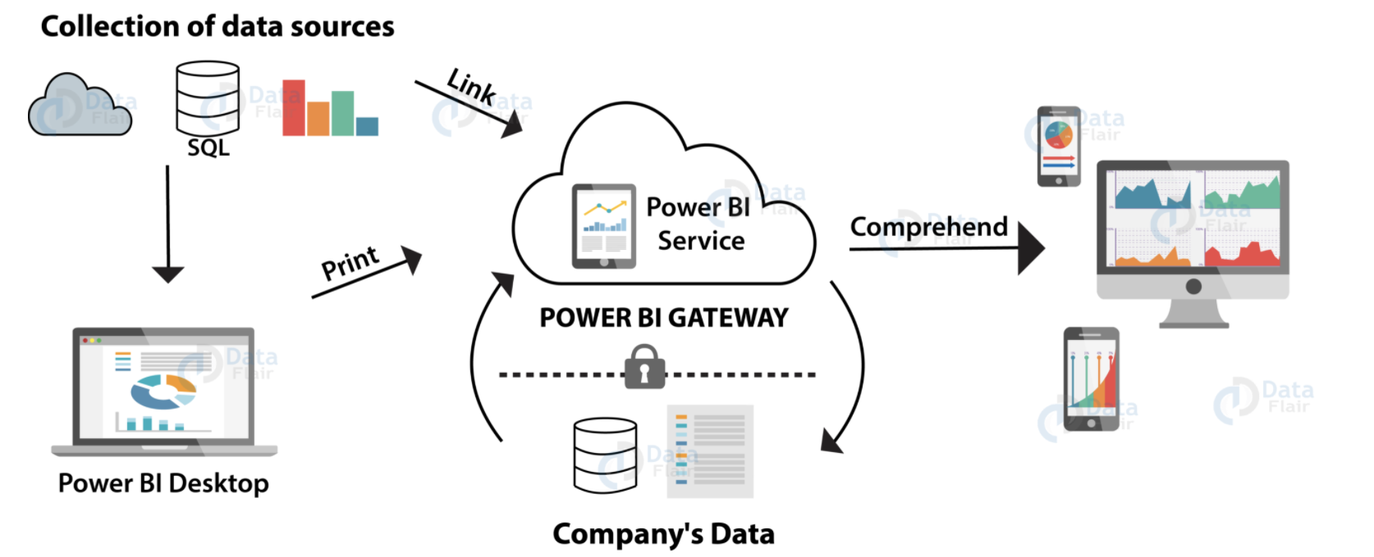
Process flow of Power BI

Slide 3
Pros
Rapid Development & Visualization
Power BI offers a wide range of visualizations (e.g., The range of visualizations includes KPIs, maps, charts, graphs, etc.).
Custom visuals are available on Microsoft marketplace.
Data Connectivity
User can import data from a wide range of data sources.
It offers data connectivity to data files (such as XML, JSON), Microsoft Excel, SQL Server databases, Azure sources, cloud-based sources, online services such as Google Analytics, Facebook, etc.

Slide 4
Cons
Handling large data volumes
Power BI has a limit of ingesting data at a time which is approximately 2 GBs of data.
Users have reported that Power BI takes a little more than usual time or even hangs while processing millions of rows and columns of data.
Limited configurability of Visuals
In most cases, you might not feel the need to configure and optimize visualizations in Power BI.
But even if you do, Power BI does not provide many options to configure your visualizations as per your requirements.
Thus, users have limited options for what they can change in visuals.

Slide 5
References
Power BI visualization
https://docs.microsoft.com/en-us/power-bi/visuals/power-bi-visualization-types-for-reports-and-q-and-a
Data connectivity
https://docs.microsoft.com/en-us/power-bi/connect-data/desktop-data-sources

